Slide 1


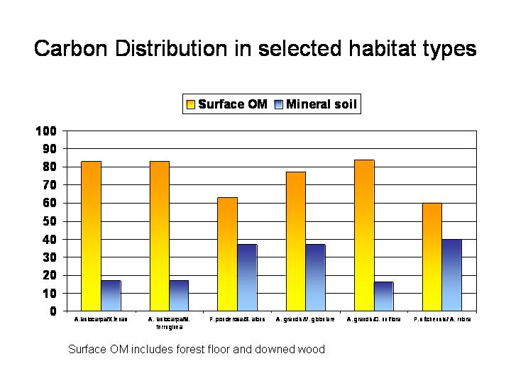
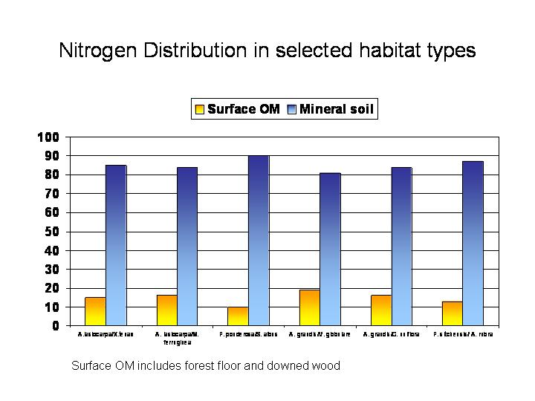
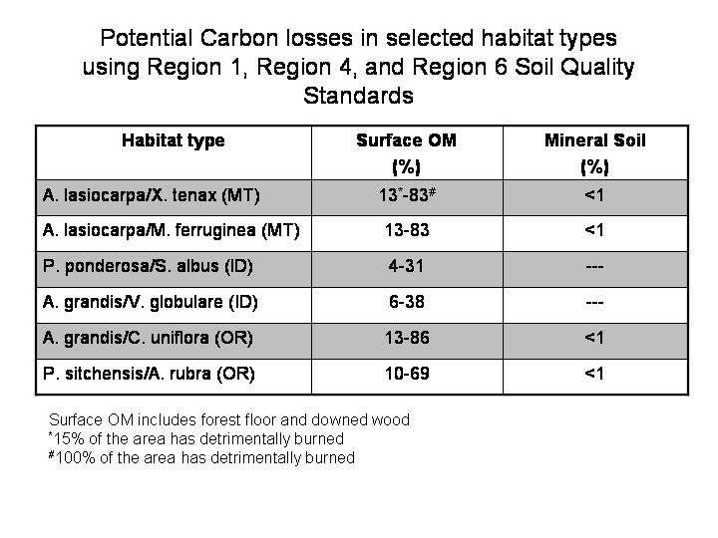

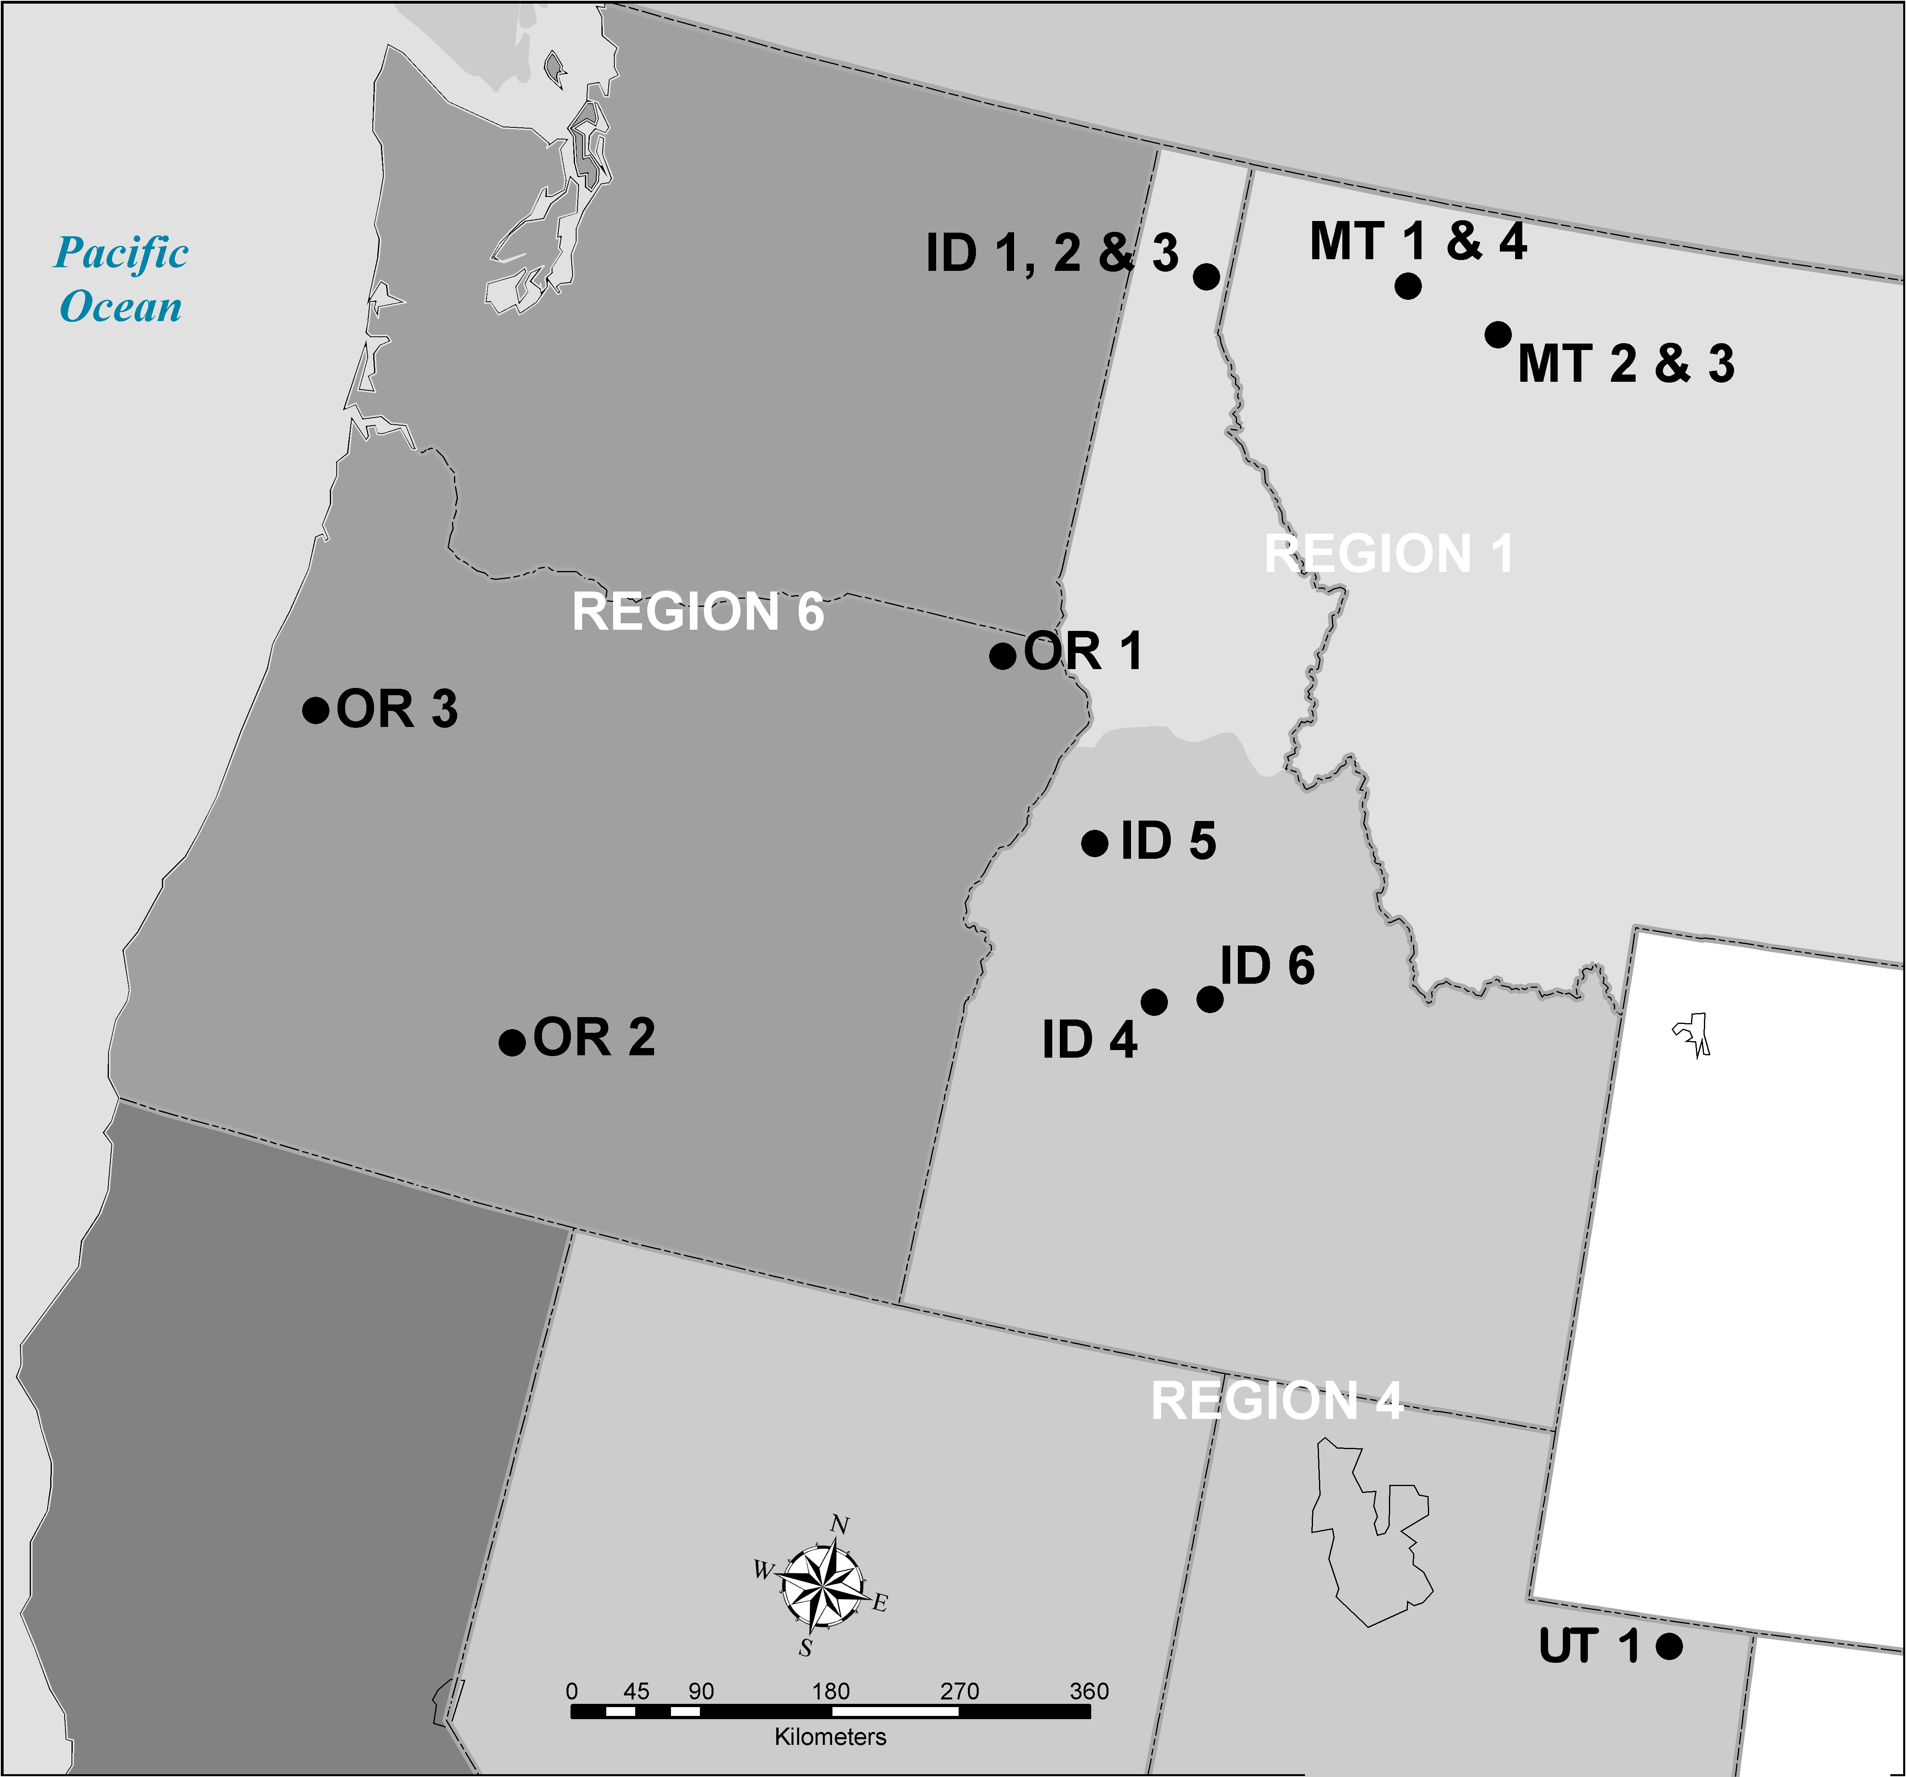
Estimating Losses of Soil Carbon and Nitrogen After
a High-Severity Fire Using USDA Forest Service Regional
Soil Quality Standards
Introduction
Using organic matter data from 14 forest stands in the northwestern USA, we found that carbon (C) is predominately pooled (53% to 83%) in surface wood residue (WR) and surface OM, which includes forest floor and soil wood. Conversely, most (>80%) nitrogen (N) was pooled in non-woody OM within the top 30 cm of the mineral soil. Using the USDA Forest Service Soil Quality Standards and Guidelines, we estimate that 7% to 86% of the pooled C could be lost during a high-severity fire depending on the proportion of area burned, the size and decay class of WR, and the distribution of OM. Losses of N from fire were much lower (2% to 23%). The variation in these estimates reflects the range of moisture, temperature, and forest types in the mid- to late-successional stands we sampled across the northwestern USA.
Fire suppression and/or exclusion in many northwestern forests has increased the amounts of WR and OM susceptible to wildfire losses. Our data suggests that C and N losses from high-severity fire could have a negative impact on soil productivity and that less severe fire in forests with low amounts of WR and soil OM may also be detrimental.
Deborah S. Page-Dumroese¹ and Martin Jurgensen²
¹⁻USDA Rocky Mountain Research Station, Forest Sciences Laboratory, 1221 S. Main, Moscow , ID 83843, USA.
²⁻School of Forest Resources and Environmental Science, Michigan Technological University,1400 Townsend Dr., Houghton, MI 49931, USA.
Methods
Results
Future Needs
Sampling: Forest floor, WR, and surface mineral soil (0-30 cm) were sampled in 14 mid- to late-successional forest stands in Idaho, Utah, Montana and Oregon (Figure 1). We also collected bulk density cores and measured woody residue via the transect method. Soils were analyzed for total C and N content and OM was estimated using weight-loss after combustion. Mineral soil C, N, and OM contents were corrected for rock content, then extrapolated to a hectare basis using the fine-fraction bulk density.
USFS Fire Guidelines: Since criteria differ among USFS Regions, we grouped our stands by the region in which they were located (Figure 1). We used the following assumptions to calculate possible C and N losses from high-severity and detrimental fires:
Region 1: High-severity and detrimental fires are similar: forest floor destroyed, and A horizon had intensive heating. We assumed 50% of the C and N in the A-horizon is lost (volatilized).
Region 4: High-severity fire: used the same criteria as Region 1. Detrimental fire: loss of either 5 cm or one-half of the naturally occurring litter layer, whichever is less. We assumed no C and N losses from the surface mineral soil.
Region 6: High-severity and detrimental fires are similar: surface of mineral soil oxidized to a red color, and next 1.5 cm blackened due to charring of OM. Although not specifically mentioned, we assumed all the forest floor is destroyed and 50% of the C and N in the surface 1.5 cm of mineral soil is lost.
Woody Residue: The impact of fire on WR is not part of any USFS Regional guidelines, but WR is mentioned as being necessary to maintain long-term soil productivity. Specific WR loss-tolerance levels are not given, so we assumed that high-severity fires destroyed all woody debris (fine and coarse) on the soil surface.
Very little information is available on total amounts of C and N in WR, surface OM, and mineral soil in individual forest stands, and the effects of fire on these pools.
Pre-disturbance stand assessments of surface and mineral soil OM pools, which will provide a basis for estimating potential C and N losses from fire
Identify stands for possible fuel load mitigation treatments.
Perspective
Post-burn assessments of surface OM are a common practice on both public and private lands to determine the effect of wild- and prescribed fires on soil properties (Page-Dumroese et al. 2000). High-severity fires can cause large losses of soil C and N, which could have a detrimental impact on soil productivity (DeBano et al. 1998). However, as seen in the Region 4 fire guidelines, less severe fires in forests with low amounts of WR and soil OM may also be detrimental. Consequently, the total fire loss of OM to total WR and soil OM pools should be evaluated to determine the potential impact of different fire intensities on soil properties (Simard 1991). Such information is important when developing harvest and site preparation techniques that reduce wildfire risk, but also maintain adequate amounts of OM for continued soil productivity and C sequestration.
Fig. 2. Carbon distribution in selected habitat
types in USDA Forest Service Regions 1, 4, and 6
Figure 3. Nitrogen distribution in selected habitat
types in USDA Forest Service Regions 1, 4, and 6
References
.
DeBano, L.F., Neary, D.G., and Ffolliott, P. F. 1998. Fire’s effects on ecosystems. Wiley and Sons, Inc. New York, NY 331 p.
Page-Dumroese, D., Jurgensen, M., Elliot, W., Rice, T., Nesser, J., Collins, T., and Meurisse, R. 2000. Soil quality standards and guidelines for forest sustainability in northwestern North America. For. Ecol. and Manage. 138: 445-462.
Simard, A.J. 1991. Fire severity, changing scales, and how things hang together. Int. J. Wildland Fire. 1: 23-34.
Figure 4. Potential losses of carbon from a high-
severity fire as determined by using the Soil Quality
Standards and Guidelines from Regions 1.4. and 6.
Figure 5. Potential losses of nitrogen from a high-
severity fire as determined by using the Soil Quality
Standards and Guidelines from Regions 1, 4, and 6
Figure 1. Location of 14 stands in USFS Regions 1, 4, and 6 sampled for this study
t

